Slide 1
OUR MISSION
Promote the practice and profession of statistics
Support excellence in statistical practice, research, journal, and meetings
Improve statistical education
Promote the proper application of statistics
Advance the statistics profession

Slide 2
What Can ASA Do For You?
Career Resources
Career Placement
Networking
Outreach
Send your ideas to the ASA Committee on Membership Retention and Recruitment

Slide 3
CAREER
RESOURCES

Slide 4
STATtr@k
A website for young statistics professionals that offers advice, professional development tips, conference information, industry news, scholarship and award information, and internship listings
Notes:
STATtr@k—A website for young statistics professionals that offers advice, professional development tips, conference information, industry news, scholarship and award information, and internship listings
<number>

Slide 5
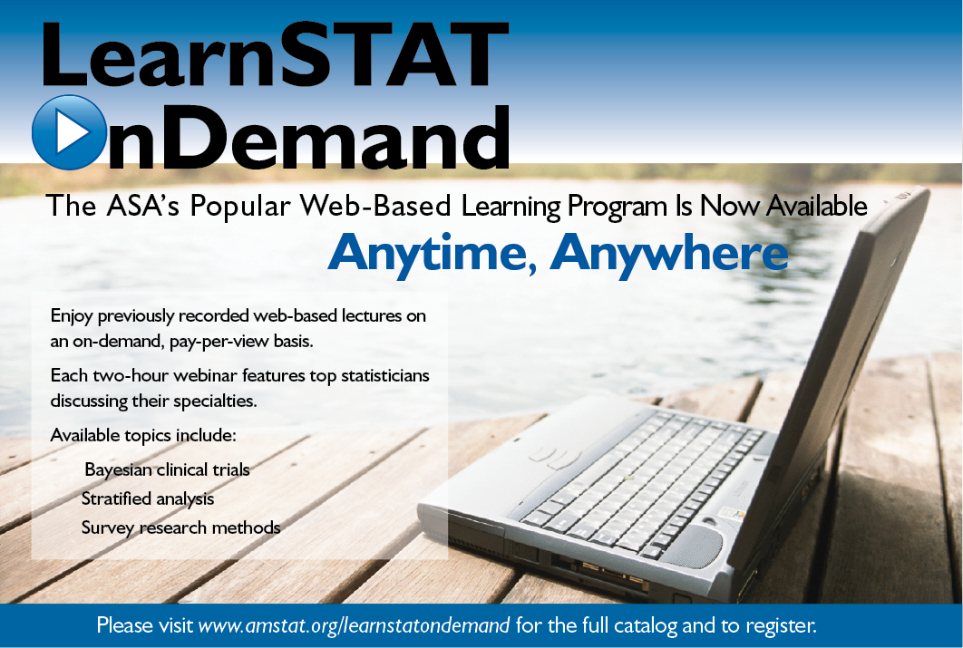
LearnSTAT on Demand
A program offering webinars taught by top statisticians in their specialties
Notes:
LearnSTAT on Demand—A program offering webinars taught by top statisticians in their specialties
<number>

Slide 6
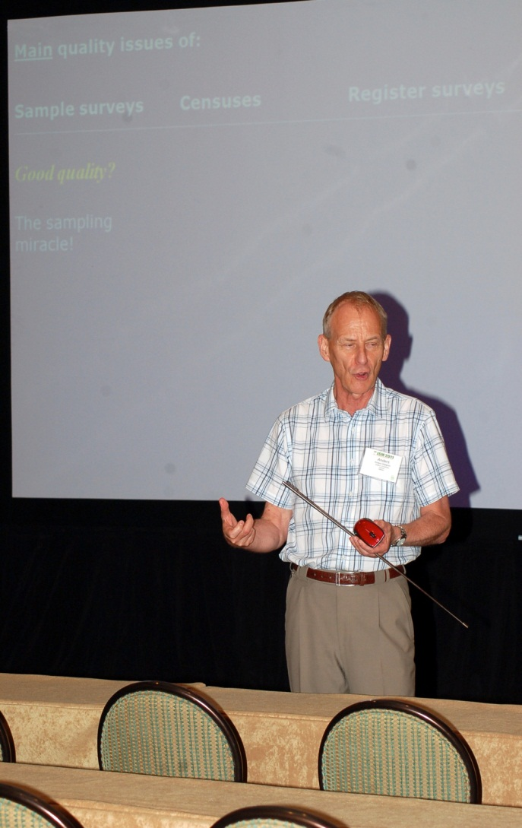
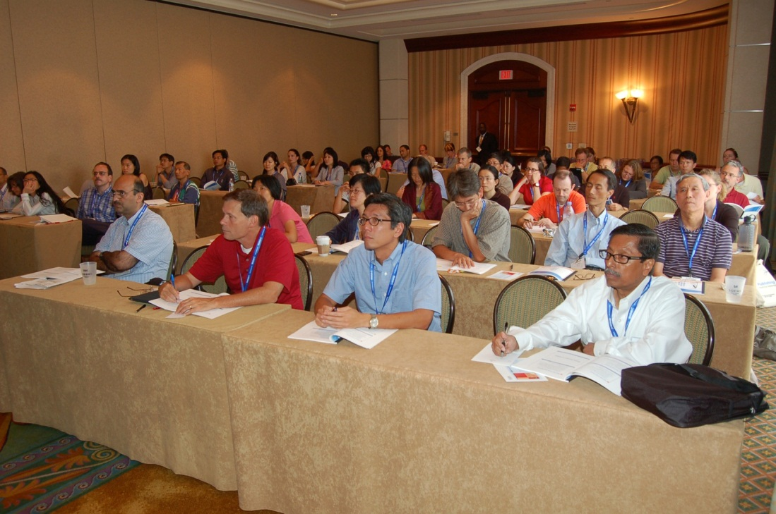
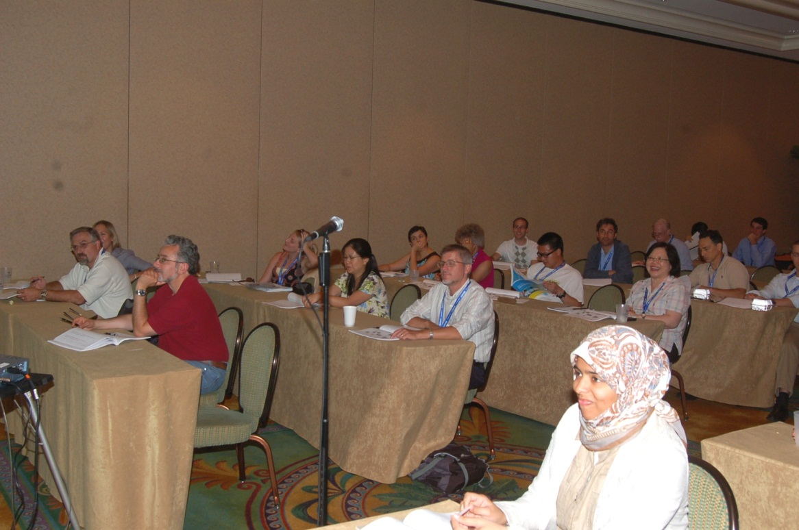
Continuing Education Courses
More than three dozen courses that are presented in conjunction with the Joint Statistical Meetings
Notes:
<number>

Slide 7
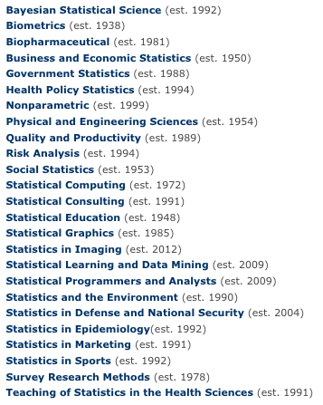
“
ASA Sections
Subject-area and/or industry-area–related groups that, among other activities, offer webinars and lectures to further the development of statistics in specialized fields
”
Also, post your consulting profile when you join the Statistical Consulting Section.
Career Webinar Sponsored by ASA’s Section for Statistical Programmers and Analysts
Notes:
<number>

Slide 8
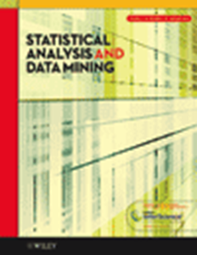
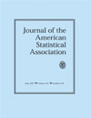
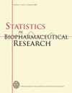
Basic Member Benefits
ASA members receive free online access to journals; discounts on workshops; and information about fellowships, awards, and scholarships
Student Paper Competitions http://www.amstat.org/sections/studentpaperawards.cfm
Notes:
<number>

Slide 9
CAREER PLACEMENT

Slide 10
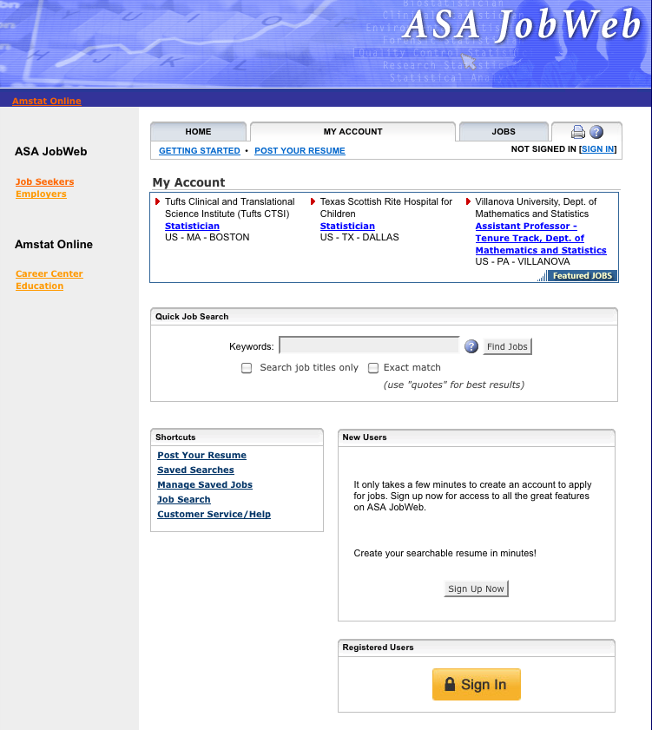
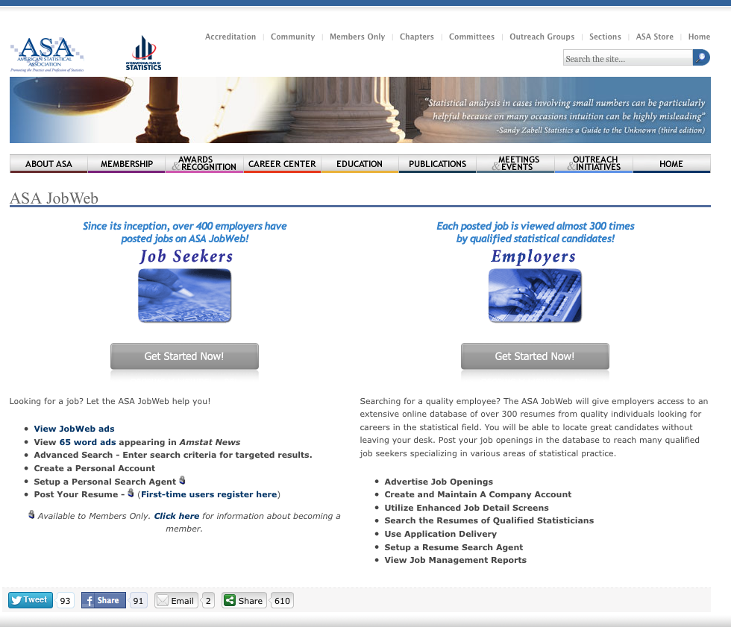
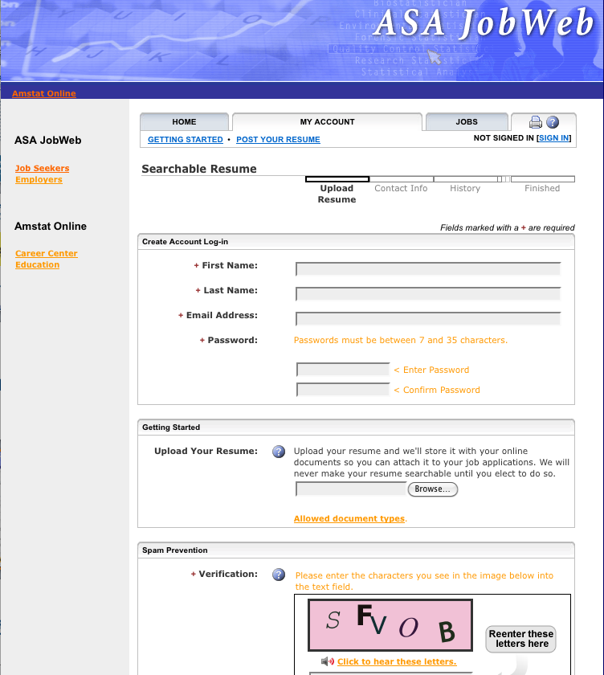
Since its inception, more than 400 employers have posted jobs on the ASA JobWeb.
John
Doe
Notes:
<number>

Slide 11
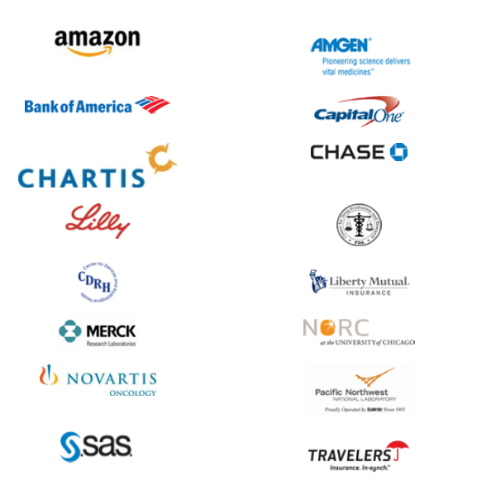
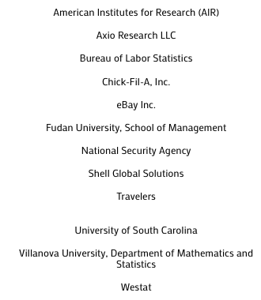
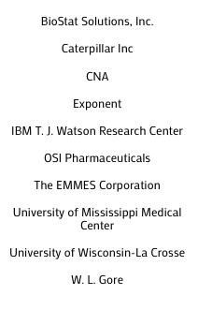
Career Placement Services
The Joint Statistical Meetings Career Placement Service is an onsite recruiting facility for employers and job-seekers. Meet recruiters in person at JSM.
Notes:
<number>

Slide 12
Amstat News
Published monthly and online, Amstat News provides a list of professional opportunities. It also features salary reports and career advice articles throughout the year.
Notes:
<number>

Slide 13
NETWORKING
OPPORTUNITIES

Slide 14
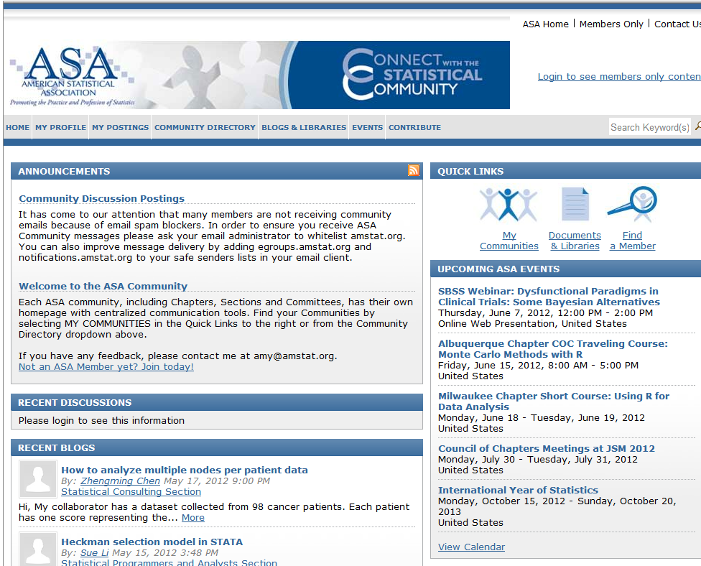
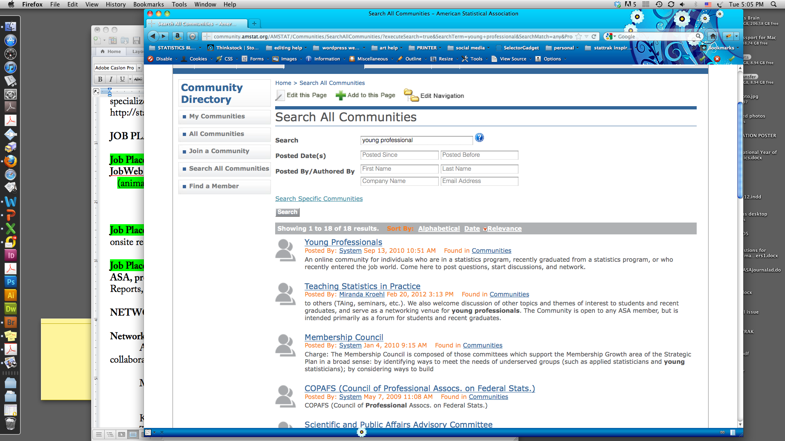
Networking Opportunities
The ASA Community is an online setting in which professionals can connect with their peers, post questions, start discussions, and network
Notes:
<number>

Slide 15
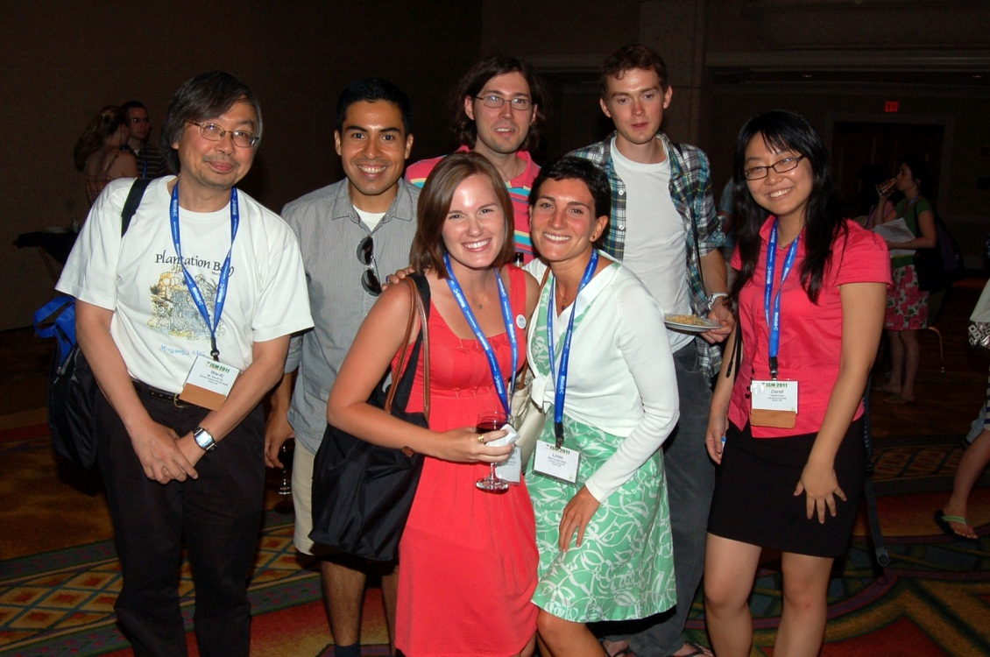
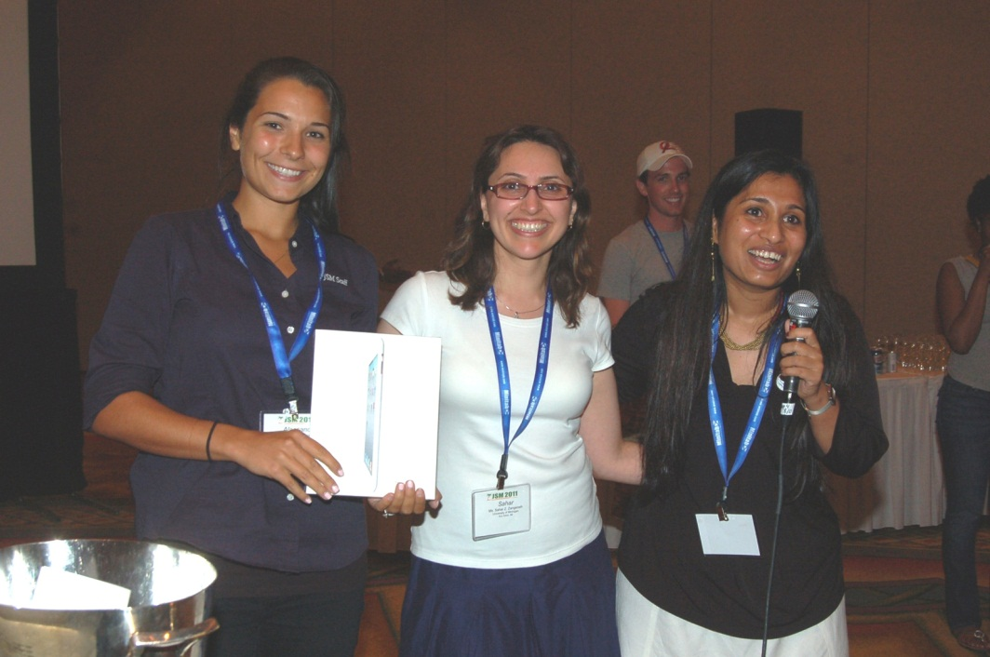
Meetings/Workshops
The ASA sponsors meetings and workshops around the world. Chapters and sections also organize smaller meetings that focus on specific areas of research and application.
JSM Student Mixer
Writing Workshop
Notes:
<number>

Slide 16
WHAT CAN YOU DO FOR THE ASA?
Should your profession be respected?
Should statistical literacy be enhanced?
Should decisions be evidence-based?
GET INVOLVED

Slide 17
OUTREACH

Slide 18
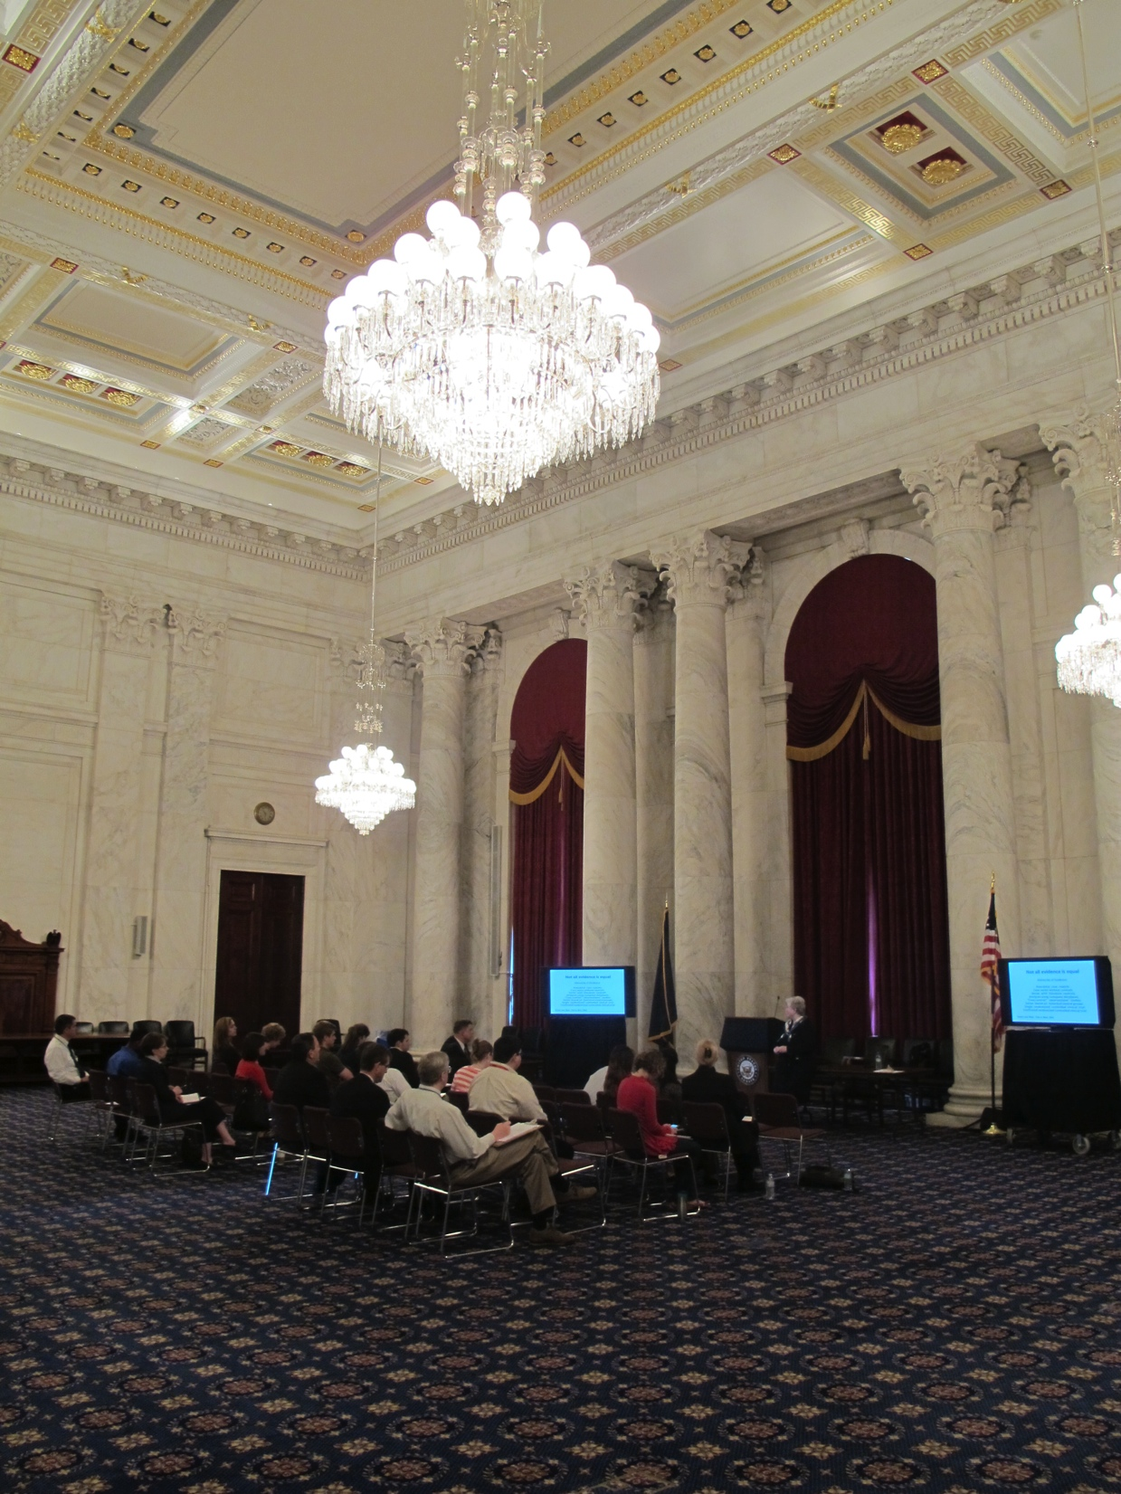
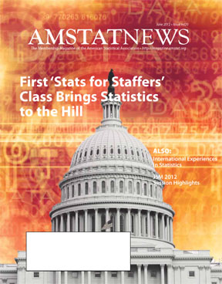
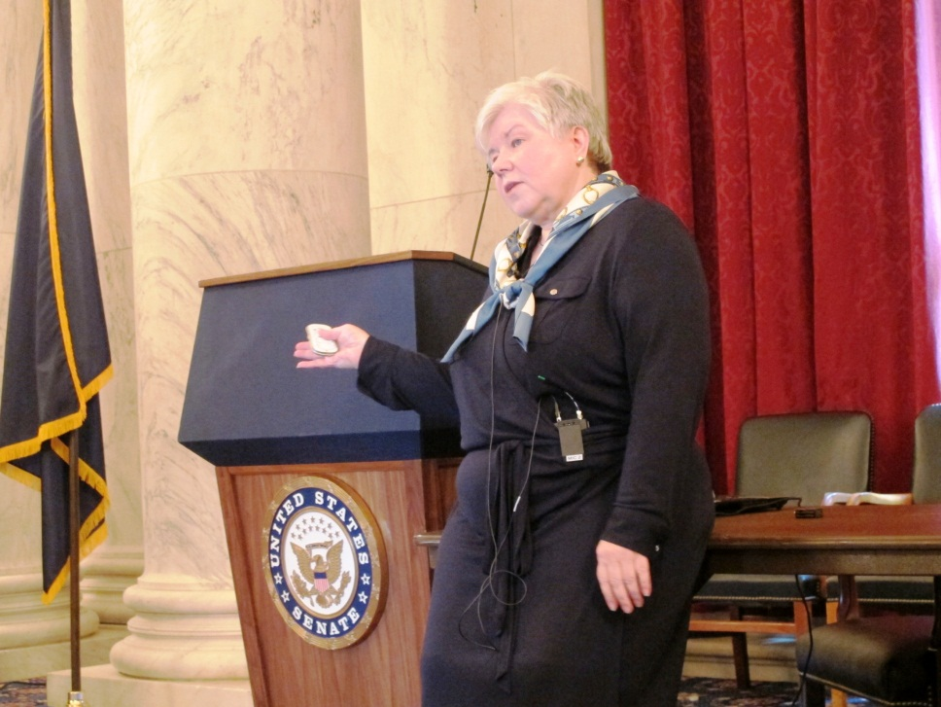
Influence Public Policy
Statisticians influence public policy by using congressional visits, letters, and board of directors statements to connect with policymakers and advocate on behalf of statisticians.
Director of Science Policy Steve Pierson
pierson@amstat.org
Notes:
<number>

Slide 19
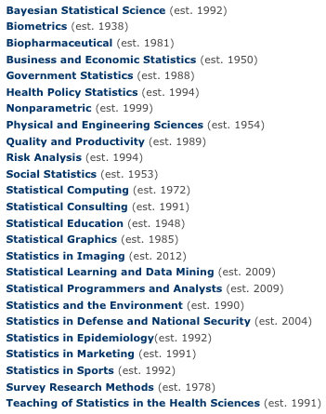
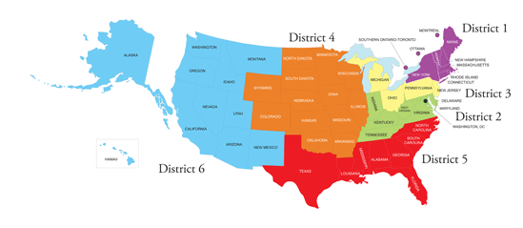
Volunteer
Volunteer for an ASA committee, chapter, or section.
Notes:
<number>

Slide 20
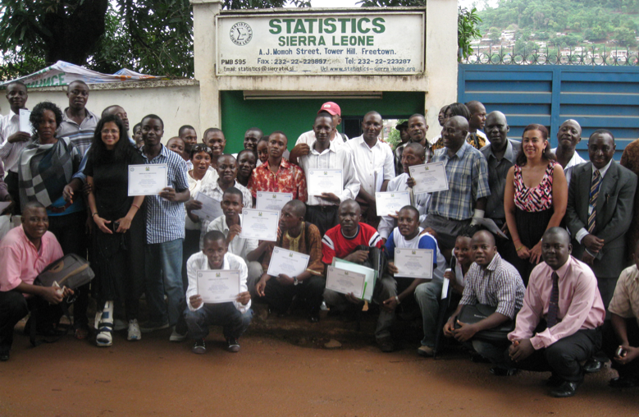
Outreach Groups
Reach beyond the typical member by getting involved in the ASA’s outreach groups
Statistics Without Borders— Comprised entirely of volunteers, this apolitical organization provides pro bono statistical consulting and assistance to organizations and government agencies.
Notes:
<number>

Slide 21
“
”
MAKE
JOIN THE ASA OR RENEW YOUR MEMBERSHIP
a difference
AND MAKE THE
ASA
influential
an
association
Notes:
<number>

Slide 22
MEMBERSHIP IN THE AMERICAN STATISTICAL ASSOCIATION:
Regular – $160
Post-graduate – $50
Student – $15
Similar Organizations’ Annual Cost
National Society of Professional Engineers – $220
American Economic Association – $70–$95
American Institute of CPAs – $200–$395
www.amstat.org
Click on Membership
Notes:
Similar Organizations’ Annual Cost
National Society of Professional Engineers – $220
American Economic Association – $70–$95
American Institute of CPAs – $200–$395
MEMBERSHIP IN THE AMERICAN STATISTICAL ASSOCIATION:
Regular – $160
Post-graduate – $55
Student – $15
www.amstat.org
Click on Membership
<number>

